Slide 1


Outer joins
CSCi 232
Alvin Lam

Slide 2
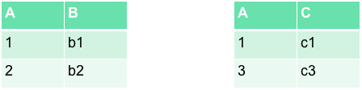
Quick review of INNER JOINs
Recall that INNER JOIN combines records from one table with ONLY matching records (based on condition) from the second table
Ex) SELECT S.B, T.C FROM S INNER JOIN T ON S.A=T.A
S
T
B | C
b1 | c1

Slide 3
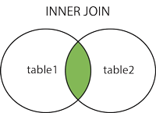
Quick review of INNER JOINs
INNER JOIN (equal) will produce one row for each pair of matching rows, but NULLs will never match.
Problem: We will always miss any rows with a NULL value for the common column we provide using INNER JOIN.

Slide 4
Outer JOIN
Outer JOINS – A type of JOIN that will combine ALL rows from one table with either matching records from the second table (if any) or with NULL (if not).
We will go over the follow types of Outer JOINs:
LEFT JOIN – Returns all rows from table to the LEFT of the word "JOIN"
RIGHT JOIN – Returns all rows from table to the RIGHT of the word "JOIN"
FULL [OUTER] JOIN – Returns all rows from both tables

Slide 5
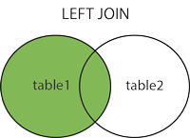
Left JOIN
Keyword: LEFT
Syntax:
SELECT <attributes> FROM <table1> [[AS] alias]
LEFT [OUTER] JOIN <table2> [[AS] alias]
<join condition> […]

Slide 6
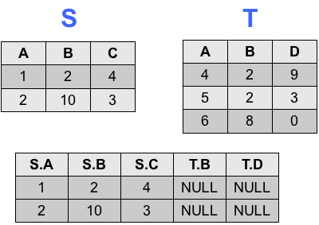
Left JOIN Example
Assume we have tables S and T
SELECT * FROM S s
LEFT JOIN T t
ON s.A = t.A;
Note: There are no common values for attribute A in both tables, however since this is a OUTER JOIN we always get ALL the rows from the LEFT table (S) and fill in the columns with NULL on a non-match.

Slide 7
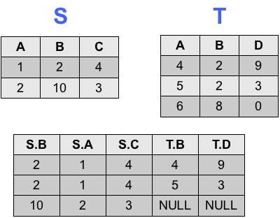
Left JOIN Example
Assume we have tables S and T
SELECT * FROM S s
LEFT JOIN T t
ON s.B = t.B;
Note: We found in table T two rows that matched S's row where B is 2. We generate the rows much like we would expect with a INNER JOIN, however we also have a row for the non-matching row where B = 10 in table S (the left table).

Slide 8
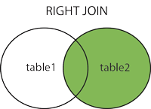
Right JOIN
Keyword: RIGHT
Syntax:
SELECT <attributes> FROM <table1> [[AS] alias]
RIGHT [OUTER] JOIN <table2> [[AS] alias]
<join condition> […]

Slide 9
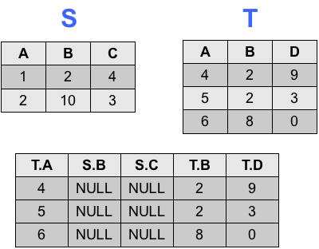
Right JOIN Example
Assume we have tables S and T
SELECT * FROM S s
RIGHTJOIN T t
ON s.A = t.A;
Note: This case is similar to the first LEFT JOIN example, we find no matching values on the common attirbute "A" but we still take ALL the rows from the right table (T) and fill the columns from S with NULLs

Slide 10
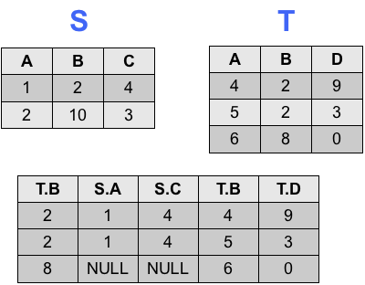
Right JOIN Example
Assume we have tables S and T
SELECT * FROM S s
RIGHT JOIN T t
ON s.B = t.B;
Note: Same case as the 2nd LEFT JOIN example, the matching rows will behave the same as a INNER JOIN with the non-matching row defaulting all values to NULL

Slide 11
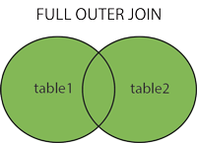
FULL JOIN
Keyword: FULL
Syntax:
SELECT <attributes> FROM <table1> [[AS] alias]
FULL[OUTER] JOIN <table2> [[AS] alias]
<join condition> […]

Slide 12
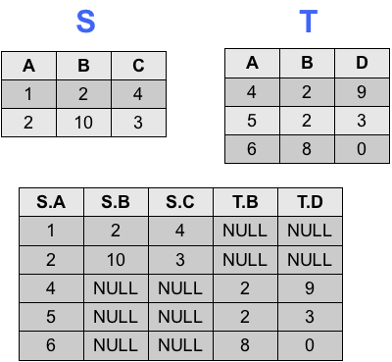
FULL JOIN Example
Assume we have tables S and T
SELECT * FROM S s
FULL JOIN T t
ON s.A = t.A;
Note: This result gives us all the rows from BOTH tables and has the same pattern we have seen so far.

Slide 13
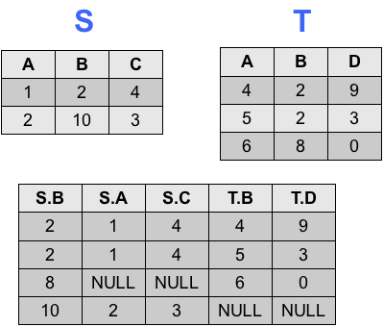
FULL JOIN Example
Assume we have tables S and T
SELECT * FROM S s
FULL JOIN T t
ON s.B = t.B;
Note: We are getting the rows we would expect from a INNER JOIN for the matching rows, but also we are getting rows for every unique value of B from both tables.

Slide 14
Outer JOIN use cases
Outer JOINs are useful for if you want to view the complete picture
Ex) Viewing all purchases made by all customers, you can detect if a customer has not purchased an item by looking for NULL values.
In this case you can see what your customers are buying and also which customers have not purchased anything in one query!
You should also think about using Outer JOINs when you might have questions on whether something exists or not.
Ex) Checking to see if someone has qualifications or not for a job.
You'll be given a table of people who have qualifications and also people who don't (denoted by NULL values).

